Slide 1
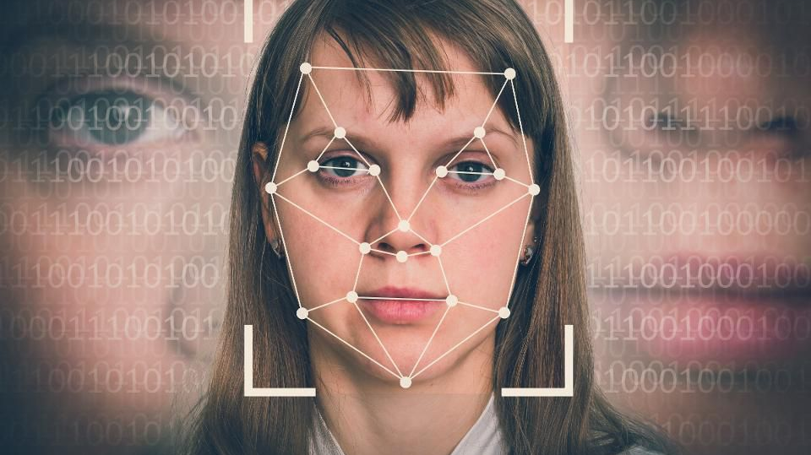
Face Recognition
Halak Patel, Huma Ghiya, Mohamed Obaidullah, Jeanette Cross, Harneet Kapil

Slide 2
Topics to be Covered:
Project Inspiration
The Data & The Scope
Machine Learning / Demo
Post-Mortem

Slide 3
Topics to be Covered:
Project Inspiration
The Data & The Scope
Machine Learning / Demo
Lessons learned / Things we would do different
Post Mortem

Slide 4
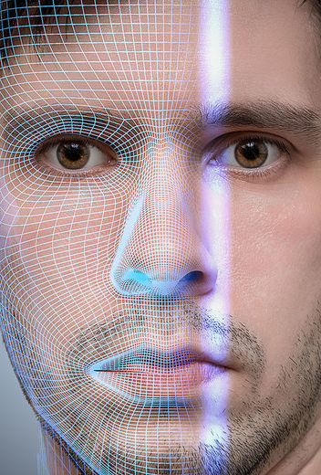
What is “Facial Recognition” ?
A Facial Recognition system is:
A technology capable of identifying or verifying a person from a digital image or video frame from a video source
Multiple methods facial recognition systems work by comparing selected facial features from given images with faces within a database
Described as a Biometric Artificial Intelligence based application that can uniquely identify a person by analyzing patterns based on the person’s facial textures and shape

Slide 5
Project Inspiration: Facial Recognition X Artificial Intelligence
Interesting and relevant topic in today’s society
Many uses of facial recognition :
Crime
Unlocking / Security for personal smart phone devices
Aid in forensic investigations
Social Media Platforms

Slide 6
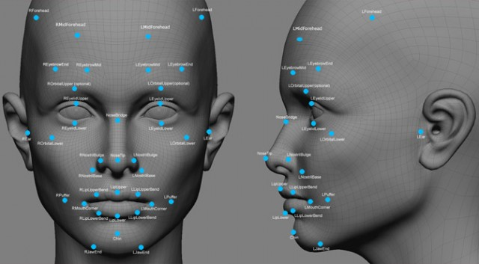
The Data & The Scope

Slide 7
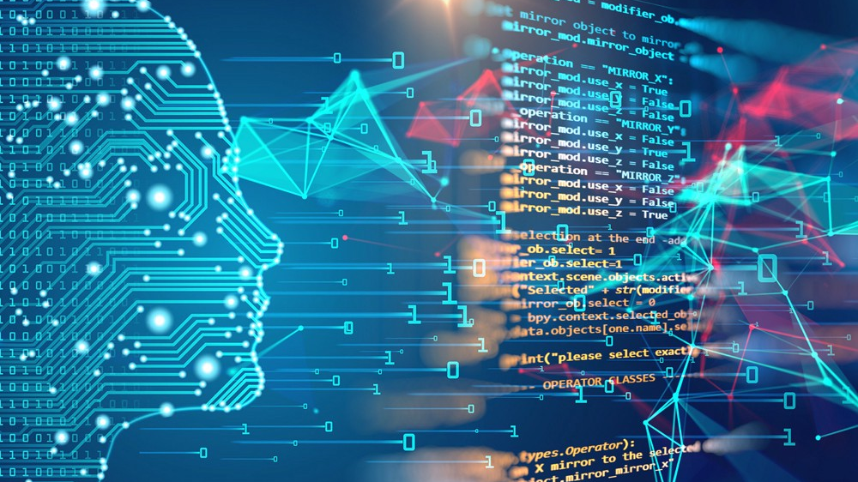
Machine Learning
Xyz
Xyz

Slide 8


Demo
Xyz
Xyz

Slide 9
Post Mortem
Xyz
Xyz

